Slide 1
Growing Corn
Moldova 2015

Slide 2
The Most Important Thing You Need to Learn at This Seminar!
“As to the methods there may be a million and then some, but principles are few. The man who grasps principles can successfully select his own methods. The man who tries methods, ignoring principles, is sure to have trouble.”
Ralph Waldo Emerson (1803-1882)

Slide 3
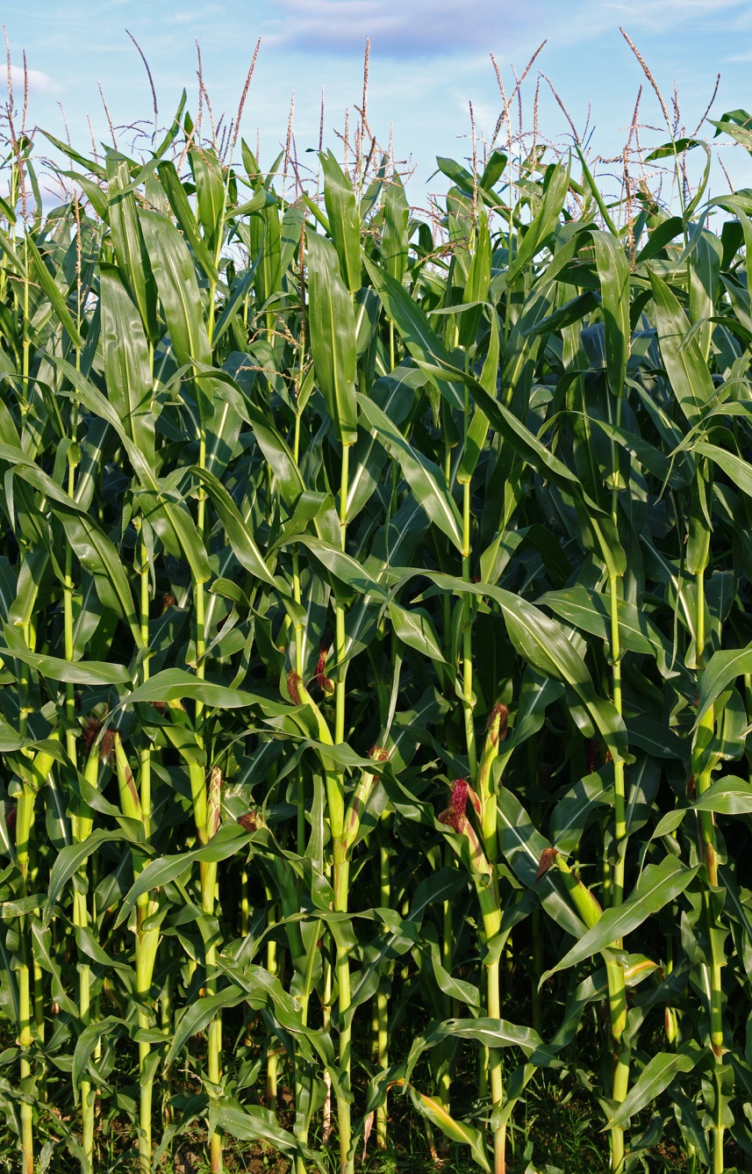
Summary
1. Variety Selection
Maturity and Traits
2. Planting
Soil Conditions
Timing and Depth
3. Nutrient Requirements
Pre/Post Plant
4. Pest Control
Weeds

Slide 4
Variety Selection…Zones 5 and 6

Slide 5
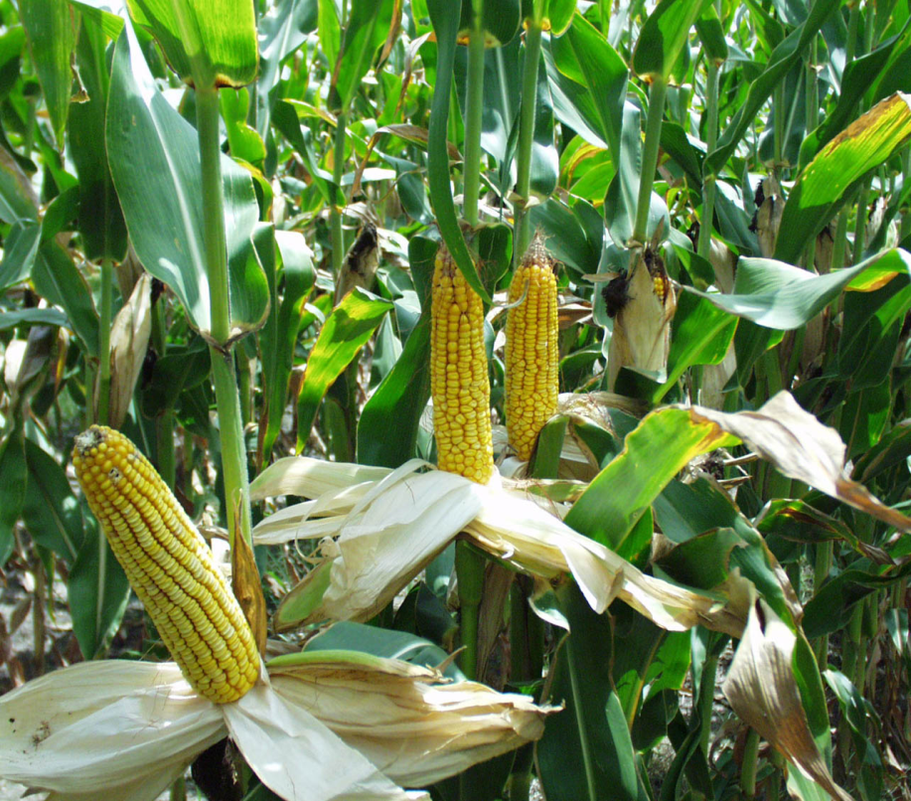
Variety Selection… Day Length
Ideal Maturity (grain use):
Zone 5 100 day +/-
Zone 6 105 day +/-
For Silage, add 3-5 days.
Important consideration, select a shorter season corn allowing for
early cover crop establishment.

Slide 6
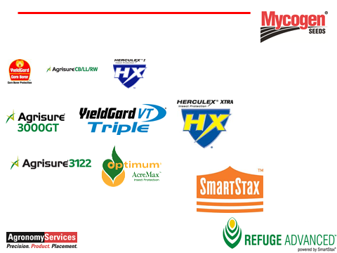
Lots of Traits, which is needed?

Slide 7
Variety Selection… Traits, Insect
Determine economic threshold by scouting or by experience.
Is the trait warranted?
Primarily needed for continuous corn hectares:
Corn Rootworm
First year Corn and areas where a high percentage of corn grown year after year.
Black cutworm, Corn Borer, Fall Armyworm,
Corn earworm.

Slide 8
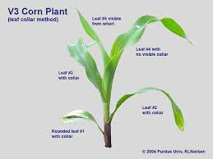
Variety Selection… Traits, Herbicide
Glyphosate …(Round-up Ready)
Makes weed control much simpler and sure

Slide 9
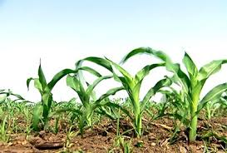
Variety Selection… Traits Silage vs Grain
Silage
Whole Plant digestibility
Soft Kernel
Low Lignin
Grain
Yield
Test weight
Standability
Dual Purpose
Grain variety with better silage attributes.

Slide 10
Variety Selection… Offensive/Defensive
Offensive Hybrid:
Puts more energy into ear.
Use on high yielding soils, irrigation, high fertility soils.
Defensive Hybrid:
Puts more energy into stalk and roots,
Defends against tough environmental conditions, such as drought, heat stress or lower producing soils.
Most ground and dry summers in Moldova needs a defensive hybrid!

Slide 11
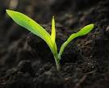
Variety Selection…Other Considerations
Seedling vigor
No-till versus conventional till.
Disease Resistance
Rotation
Flex versus Determinate ear type
Determines planting population along with soil productivity.

Slide 12
Variety Selection…Other Considerations
Plant Stature and Leaf Architecture
Short versus Tall,
shade and standability considerations.
Upright versus Pendulum Leaf habit
Impacts sunlight absorption versus canopy penetration.
May have implications if cover crop is broadcast mid to late season in standing corn

Slide 13
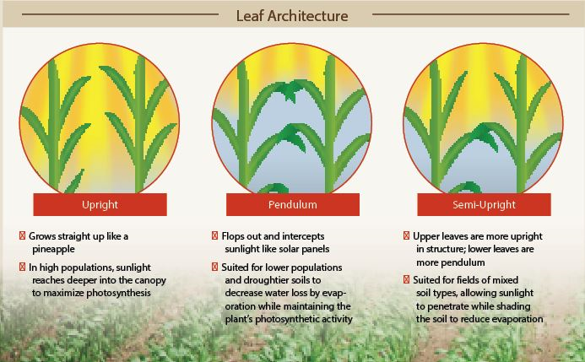

Slide 14
Planting Considerations
Planting Depth 1.5” to 4”
Where is the moisture and heat?
Key to proper nodal root development.
50 degrees or higher, at planting depth
(seed can take up moisture below this temp, but will not germinate.)
Smooth/crumbly seed bed…no clods
(seed to soil contact for moisture uptake)

Slide 15
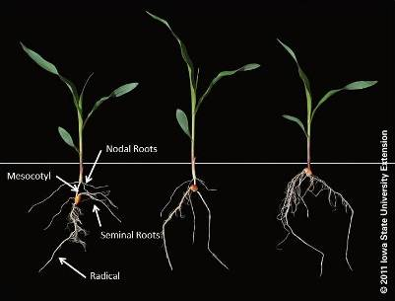
Nodal root development and planting depth

Slide 16
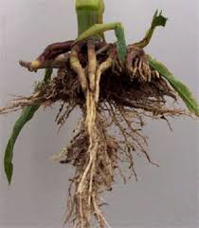
Planting Thoughts
Getting a plant off to a good start, is one thing you have control over. And It is half the battle for a high yielding, healthy crop.
Planting into soil conditions that are too wet, cold or compacted can haunt the crop all year.
Sidewall
Compaction

Slide 17
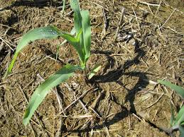
Take no short cuts with the corn planter. Get it tuned and ready well before planting time. There may only be 8 or 10 days all year that are ideal for planting, make sure you are ready on every one of those days.

Slide 18
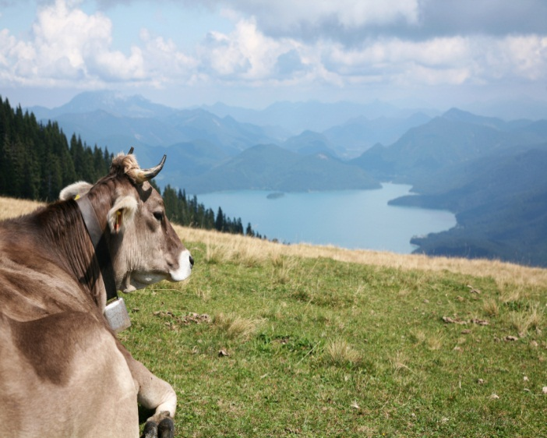
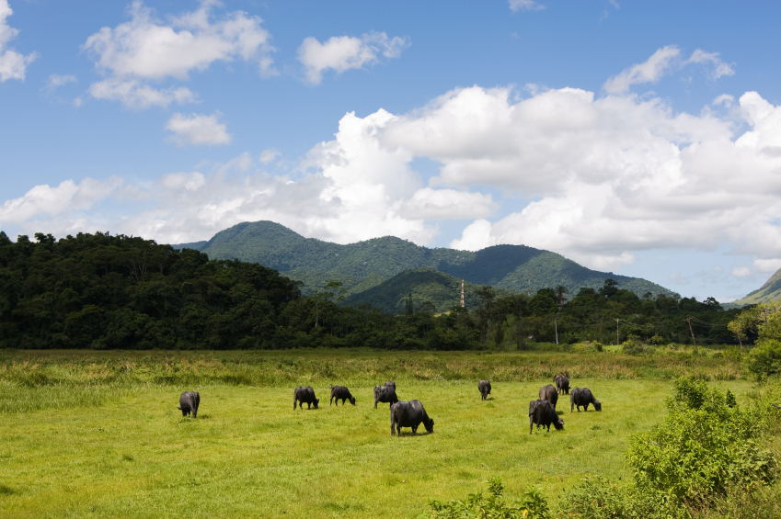
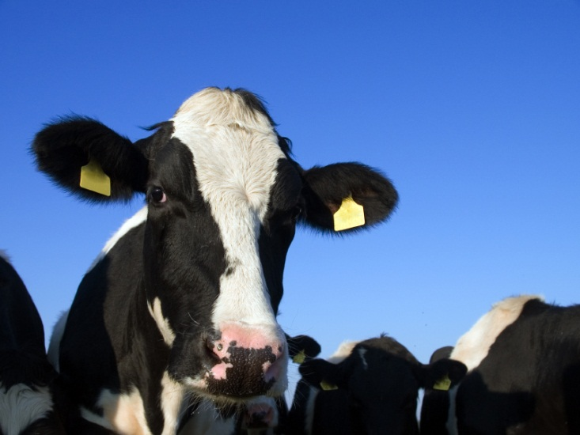
Nutrient Needs

Slide 19
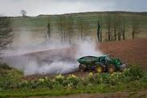
Nutrient Requirements
The Most Important: pH (Lime)
pH determines availability of all the nutrients.
Ideal Range for corn 6.5-7.0

Slide 20
Nutrient Requirements
If possible, start with a Soil Test, taken the previous fall.
25-30 Ton/ac can supply most of a corn crops needs. Depends on timing of application and incorporation.

Slide 21
Nutrient Requirements
CORN NUTRIENT NEEDS in kg/ha
Based on a Yield Goal of 10 mt/ha.
Nitrogen 150-180 kg/ha Ideally split applied
Phosphorus 22-65 kg/ha on the row
Potassium 45-90 kg/ha broadcast
Sulfur and Micro Pack recommended for yield and quality.

Slide 22
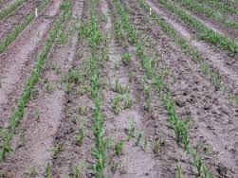
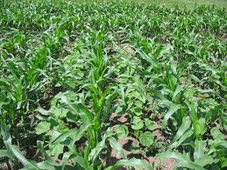
Weed Control
Key: Control weeds early, 1-2” tall.
Or smaller. Picture on the left is ready to be sprayed (post emerge), one on the right is too late, yield and moisture is already lost.

Slide 23
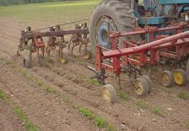
Weed Control
Mechanical Control,
cultivate early and often.
Tough to control perennial weeds.

Slide 24
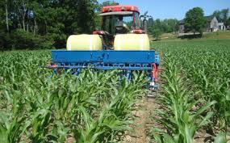
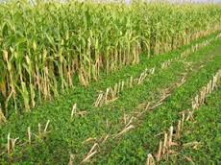
Weed Control
Interseeding cover crop is now being used on a limited basis in the US.
Late season moisture is key for this to work.

Slide 25
Weed Control
Prevent with crop rotation, cover crops and not allowing weeds to produce seeds
Forage Radish, Buckwheat and others can suppress weeds if thick stands are planted the fall/summer prior to planting corn. (for example, after wheat)

Slide 26
Weed Control
Chemical Control: Timing is key
Glyphosate, weeds must be emerged.
1-2” in height.
Atrazine/Acetochlor etc… apply prior to
weed emergence. Adequate soil prep.
Follow label and use protective clothing.

Slide 27
